Slide 1

Process Mining Virtual Internship
by
P.Pavithra
Roll No. 214G1A3275
Department of Computer Science and Engineering (Data Science)
Srinivasa Ramanujan Institute of Technology
(Affiliated to JNTUA & Approved by AICTE) (Accredited by NAAC with ‘A’ Grade & Accredited by NBA (EEE, ECE & CSE)
Rotarypuram Village, B K Samudram Mandal, Ananthapuramu – 515701.
2023 - 2024

Slide 2

Contents
Course Objective
Introduction
Technology
Applications
Modules
Real Time applications
Learning outcomes
GitHub Link
Queries

Slide 3
Course Objective
Learn about the different types of process mining, such as discovery, conformance checking, and enhancement. They could also learn about the process mining lifecycle, which includes the steps of collecting event data, cleaning event data, creating a process model, and analyzing the process model.
Learn about the syntax of PQL queries and how to use them to extract insights from event data. They could also learn about the different types of PQL queries, such as event queries, activity queries, and trace queries.
Learn how to import event data into EMS using a variety of methods and also learn how to configure EMS to analyze the event data.

Slide 4
Introduction
Process Mining is a modern way to understand how businesses work using data. It's like a clear and complete picture that helps us see how things are really happening. This helps a lot in making good decisions and improving how things are done.
Process mining is a data-driven approach used to analyze, visualize, and understand business processes based on event data stored in information systems. It involves extracting valuable insights from event logs generated during the execution of various processes.
The goal of process mining is to turn event data into insights and actions.
It's the key to understanding how your processes really function, providing insights that drive informed decisions. With process mining, you can identify bottlenecks, optimize workflows, and enhance efficiency.
Process mining is starting with the basics, you'll gain a solid understanding of what process mining is and how it works. We'll demystify event logs, process models, and the key concepts that underpin process mining.
In Process Mining we also learn about PQL queries and Get Data into EMS to analyze the event data.

Slide 5
Process mining Technology
Process mining technology is an advanced approach that involves using data from various sources within an organization to understand, analyze, and improve its business processes. It's a data-driven methodology that unveils the actual flow of activities, decisions, and interactions within processes, providing insights to enhance efficiency and effectiveness.
Process mining uses data to discover, analyze,monitor and improve real-world processes.
Process mining technology is the software and tools that are used to perform process mining.
Some of the Process Mining technologies such as Celonis,Process Gene,Disco and Minit
Process Mining Technology involves:
Event log: An event log is a data source that process mining algorithms use to discover, analyze, and enhance process models.
Process model: A process model is a graphical representation of the process. It can be used to communicate the process to stakeholders, identify problems, and track the performance of the process.

Slide 6
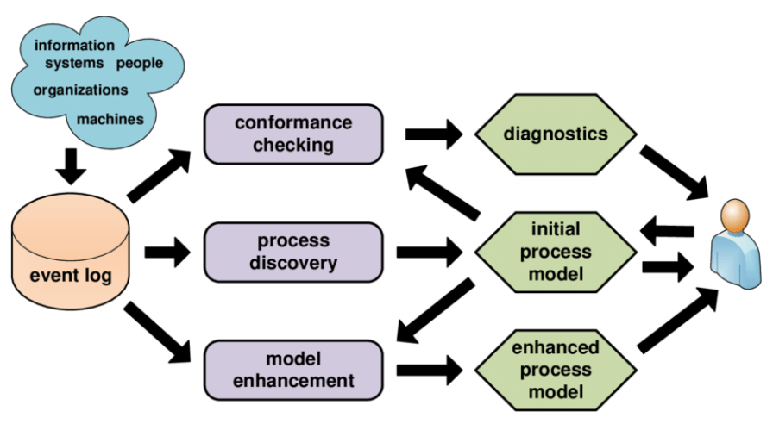
Continued...
Metrics: Metrics are used to measure the performance of the process. They can be used to identify areas for improvement and track the effectiveness of changes that have been made.
Process discovery: Process discovery is the process of finding the underlying process model from event data.
Conformance checking: Conformance checking is the process of checking whether the actual process conforms to the desired process model.
Enhancement: Enhancement is the process of improving the process model based on the analysis of event data.

Slide 7
Applications
Process mining is a powerful tool that can be used to improve the efficiency and effectiveness of business processes. It can be used for a variety of applications, including:
Discovering and Documenting process
Analyzing process
Monitoring process
Enhancing process
Compliance checking
Risk Assesment
Resource allocation
Customer Experience improvement
Root cause analysis

Slide 8
Modules
PROCESS MINING FUNDAMENTALS
There are three main types of process mining are: process discovery,conformance checking, and process enhancement.
Celonis is a process mining software platform that helps organizations to discover, analyze, and improve their business processes.
Celonis uses event data to create process models, analyze process performance, and identify opportunities for improvement.
Celonis Analyses:
Celonis Analysis uses the Celonis platform to understand how a business operates. It starts by collecting data from different parts of the company, like sales and customer service. This data is organized and turned into a timeline of activities called event logs. Celonis then uses these logs to create pictures of how the business works, showing how things happen and where there might be problems.

Slide 9
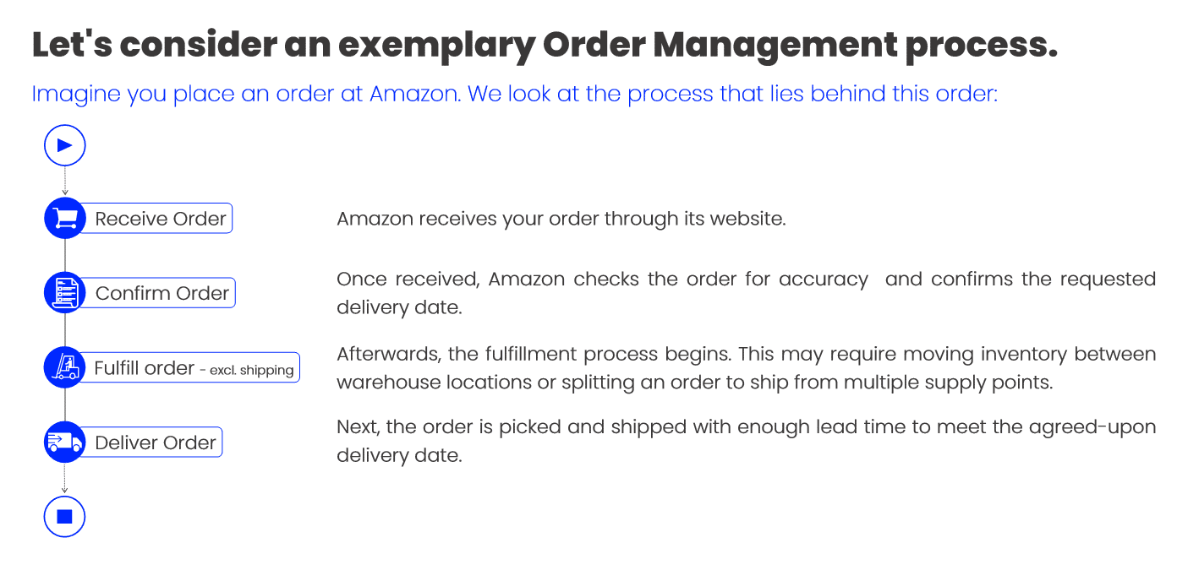
Continued...
Variability and Variant Analyses:
Variability and variant analyses in Celonis are used to understand the different ways that a process can be executed. This can be done by identifying the different paths that a case can take through the process, as well as the different activities that can be performed at each step.

Slide 10
Continued...
Process Variability: Defining process variability as the existence of different paths in a process due to exceptions or choices.
Variant Analysis: Explaining how variant analysis helps understand the frequency and implications of different process paths.
some of the benefits of using variability and variant analyses in Celonis:
Improved understanding of processes: Variability and variant analyses can help to identify the different ways that a process can be executed. This information can be used to improve the understanding of the process and to identify areas for improvement.
Identification of opportunities for improvement: Variability and variant analyses can help to identify the variants of the process that are causing the most problems or that can be improved. This information can be used to improve the process by making changes to the way it is executed.

Slide 11
PQL Queries
In process mining, Process Query Language (PQL) is used to retrieve and analyze data from event logs to gain insights into business processes.The intention of Celonis PQL is to provide a query language for performing process mining tasks on large amounts of event data.The event and business data as well as all results (including the mined process models)are represented as relational data.
some basic PQL queries:
SELECT* FROM Activities
SELECT ActivityName, AverageDuration FROM Activities
SELECT ActivityName, AverageDuration WHERE ActivityName = 'Order Placed'
SELECT * FROM Activities WHERE ActivityName IN ('Order Placed', 'Order Approved', 'Order Shipped')
SELECT * FROM Activities WHERE ActivityName LIKE '%Placed%'
Example for basic coding in PQL
SELECT AVG(timestamp_diff("order_received", "order_completed", 'seconds'))
FROM "Order_Process"

Slide 12
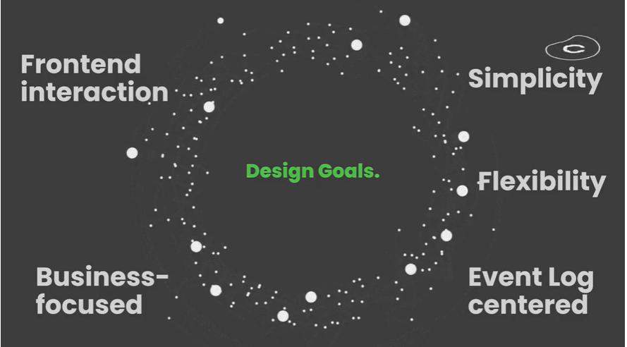
Continued...
Design goals of PQL
The first version of Celonis PQL was an extension to SQL. While it had several convenient process mining functions, the actual queries evaluated on the database were complicated. Furthermore,it was difficult to extend the language with new functionality. To overcome these issues, the query language was redesigned based on previous experiences, with the following design goals in mind:

Slide 13
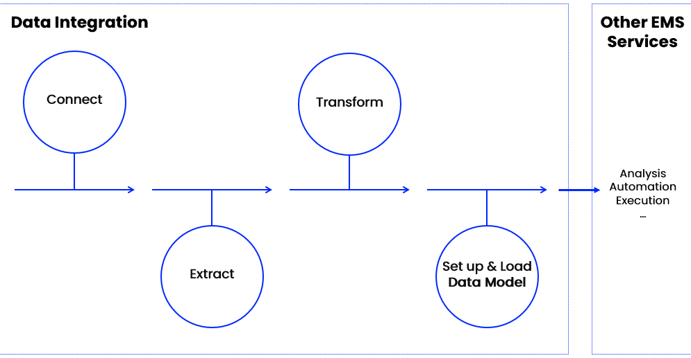
Get Data into EMS
As a data engineer or analyst working in Data Integration (formerly known as Event Collection), you’re responsible for bringing in clean, real-time process data into the EMS. In other words, you build the data pipeline.
Set up your Data pipeline
Data Integration helps you connect to source systems, extract the relevant data, transform it to your needs, and load it into a polished Data Model. You can think of the Data Model as the fuel to all other work in your EMS.

Slide 14
Refine your Data pipeline
A data pipeline in the context of an Event Management System (EMS)involves the structured flow of event data from various sources through a series of processes to ultimately make the data usable for analysis, visualization, and decision- making in process mining.
overview of a refined data pipeline within an EMS:
Data Source Integration and Data ingestion
Data Storage and Transformation
Data Enrichment and Data Aggregation
Data Storage and Management
Process Mining Integration
Visualization and Reporting
Continuous Monitoring and improvement

Slide 15
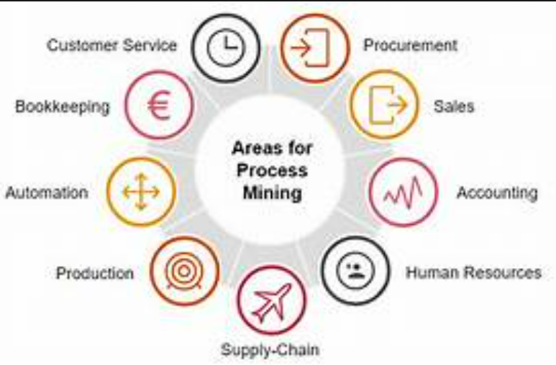
Real Time Applications
Financial services
Fraud detection
Healthcare

Slide 16
Learning outcomes
An understanding of the different types of process mining
An understanding of the different tools and techniques that can be used for process mining
The ability to identify potential applications for process mining in your organization
The ability to import data into Celonis
The ability to create process models in Celonis
The ability to analyze process data in Celonis
The ability to identify and improve process bottlenecks in Celonis

Slide 17
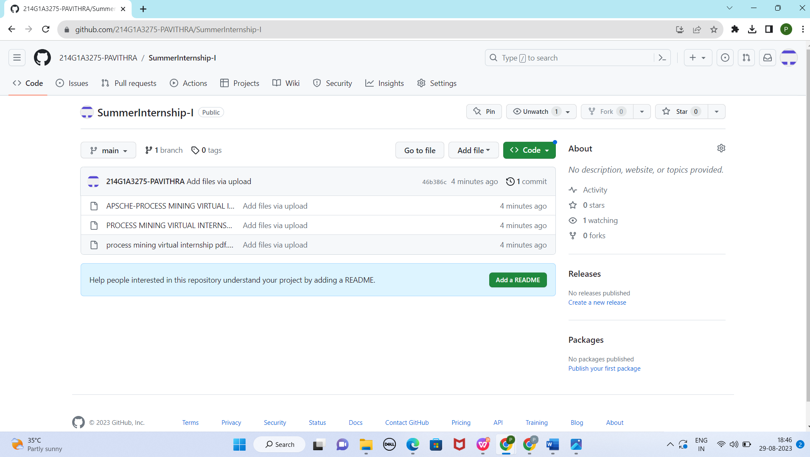

Git Hub Dashboard

Slide 18
Any Queries?

Slide 19
Thank You!!!

